Slide 1
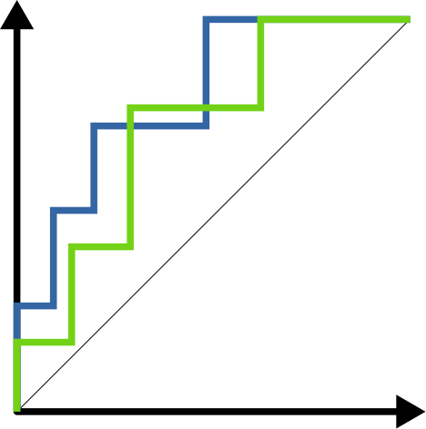

Lecture 19.3
Evaluating classification performance
Nicola Romanò nicola.romano@ed.ac.uk

Slide 2
Learning objectives
At the end of this lecture you will be able to:
Explain the concepts of
confusion matrices
ROC and AUC
Cross-validation
Choose an appropriate classification threshold
Compare different classifiers
R workshop #6 on classification will show you how to practically apply these concepts and perform these analyses in R (will be published on Learn on 27th March).
Notes:
4

Slide 3
Classification algorithms
Problem
We are interested in a discrete outcome (e.g. yes/no, mild/medium/severe)
Collect data from several subjects (outcome + predictors)
We want to predict the outcome for a new set of predictors
Many different classification models exist; classification trees, RandomForest, SVM, logistic regression, Naïve Bayes …
How do we choose one?
Need a measure of how good is the model prediction
In the next lecture we will talk about specific methods!
Notes:
4

Slide 4
Predicting heart disease
303 patients with chest pain syndrome undergoing angiography at Cleveland Hospital
96 women, 207 men
Data collected between May 1981 and September 1984.
Outcome variable: heart disease → binary yes/no
Descriptors*:
Age
Gender
Resting heart rate (bpm)
Cholesterol level (mg/dl)
Exercise-induced angina (yes/no)
Chest pain type (typical anginal, atypical anginal, nonanginal, asymptomatic)
* the full “Cleveland dataset” has more descriptors
Given a new patient of a certain age/gender/etc. can we predict whether they are at risk of heart disease?
Notes:
From the “Cleveland database”
4

Slide 5
Fitting a model
For this example we can use logistic regression
model <- glm(Disease ~ ., data = heart, family = "binomial")
summary(model)
[…]
Coefficients:
Estimate Std. Error z value Pr(>|z|)
(Intercept) 7.710271 1.608494 4.793 1.64e-06 ***
Age -0.057784 0.018142 -3.185 0.00145 **
SexM -1.844392 0.368588 -5.004 5.62e-07 ***
RestBP -0.018822 0.008869 -2.122 0.03382 *
Cholesterol -0.003652 0.002974 -1.228 0.21942
ExAng -1.423848 0.334959 -4.251 2.13e-05 ***
ChestPain 0.839769 0.155814 5.390 7.06e-08 ***
The dot means to use all the other columns
Notes:
4

Slide 6
Using the model for prediction
The predict function can be used to predict new outcomes from a model
new.patient <- data.frame(Age = 45,
Sex = "M",
RestBP = 125,
Cholesterol = 350,
ExAng = 0,
ChestPain = 2)
predict(model, new.patient, type = "response")
1
0.7882252
There is ~79% probability that the patient will have heart disease.
See Workshop 4 for another example!
Notes:
4

Slide 7
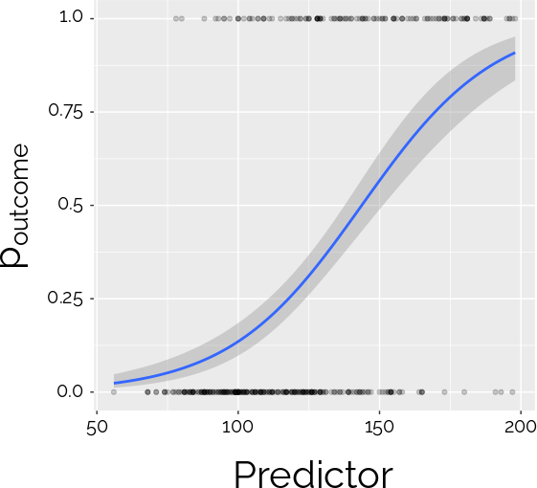
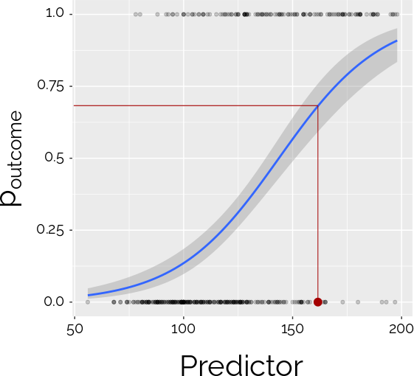
Generating binary outcomes
Do we classify this as positive or negative?
Notes:
4

Slide 8
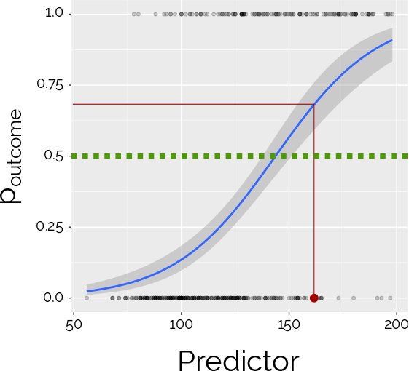
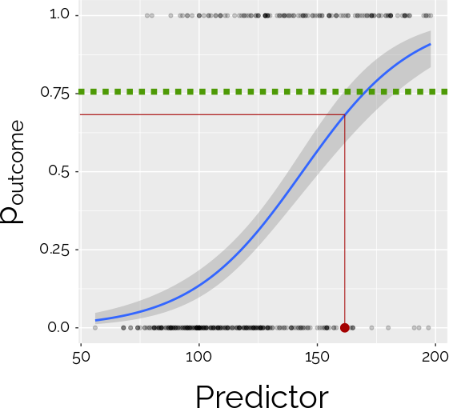
Setting a threshold
Positive
Negative
ifelse(predict(model, new.patient, type = "response") > threshold, 1, 0)
Condititon
If true
If false
In what instances would you use a threshold different from 0.5?
NOTE: although most classification methods return a probability, some only return a label (positive/negative). The concept of threshold does not apply to those methods.
Notes:
4

Slide 9
OK but… how good is our model?
We are still unsure…
What model do I choose?
What parameters and threshold do I choose?
How do I know if the model prediction was right?
Notes:
4

Slide 10
Test and training sets
Randomly divide the data for which you have labels into a training set and a test set
The training set is used to generate (in ML this is called training) the model
The test set is used to test how good the predictions of the model are!
Notes:
4

Slide 11
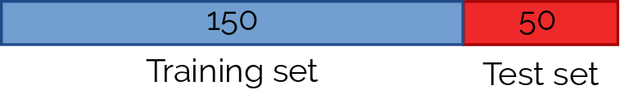
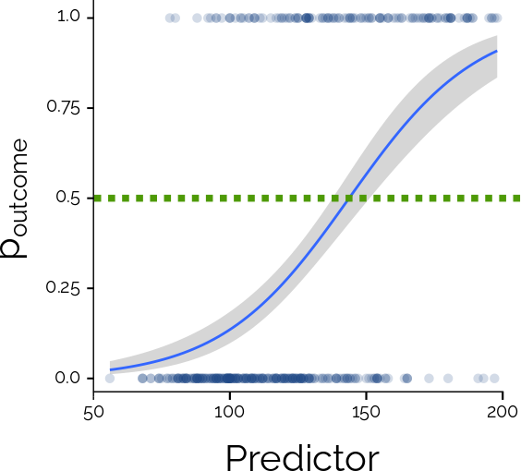
Test and training sets
Apply the prediction to the test set
Prediction 1, 0, 1, 1, 1, 0, 0, 0, 0, 1, 0
Check how good the model did!
(we know the labels!)
Run the model on the
training set
Apply the model to a new unlabelled dataset!
Notes:
This is called hold-out validation
4

Slide 12
The confusion matrix
A confusion matrix tells us how good our model is at classifying
Actual
 | Disease | No disease
Disease | 24 (true positives) | 1 (false positive)
No disease | 5 (false negative) | 20 (true negatives)
Predicted
Sensitivity = TP / (TP + FN) = 24 / (24 + 5) = 0.83 = 83% (% true positives)
Specificity = TN / (FP + TN) = 20 / (20 + 1) = 0.95 = 95% (% true negative)
Notes:
4

Slide 13
Test and training sets
Problem: why choose the last 50 observation (or the first 50, for that matter)?
We risk overfitting the model to the training set!
This means that the model is very good at classifying the training set, but may perform poorly on other data. This is also called variance.
Notes:
4

Slide 14
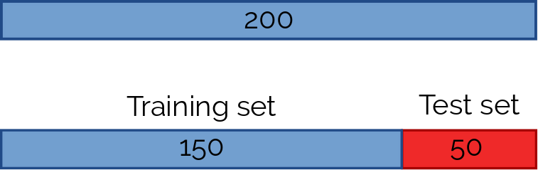
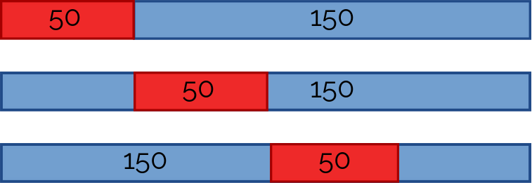
Cross-validation
Generate model on training set, apply to test
Generate model on training set, apply to test
Generate model on training set, apply to test
Generate model on training set, apply to test
Generate confusion matrix!
We call this 4-fold cross-validation.
If we divided the data into 10 we would call it 10-fold cross-validation, etc.
Notes:
Leave-one out cross validation
4

Slide 15
CV of heart disease dataset
We call perform CV in R using the caret package (code will be in the workshop)
10-fold CV on the heart disease dataset
Cross-Validated (10 fold) Confusion Matrix
(entries are percentual average cell counts across resamples)
Reference
Prediction 0 1
0 32.3 8.9
1 13.2 45.5
Accuracy (average) : 0.7789
Notes:
Accuracy = %TP + %TN = % correct classification
4

Slide 16
CV of heart disease dataset
So… now we have a way of telling how good our model is!
We can:
Compare different models
Compare the same model with different parameters (e.g. different logistic regressions classifying using different thresholds)
Notes:
4

Slide 17
ROC curves
A Receiver Operating Characteristic (ROC) curve shows the classification ability of a binary classifier at different thresholds.
We plot Specificity and Sensitivity while varying the threshold
The area under the curve (AUC) is a good measure of how well the classifier predicts the outcome
Notes:
4

Slide 18
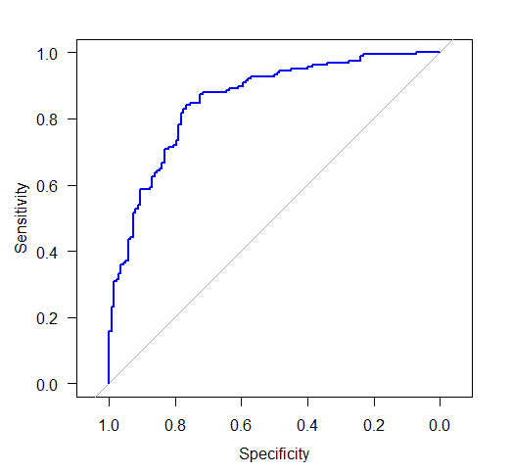
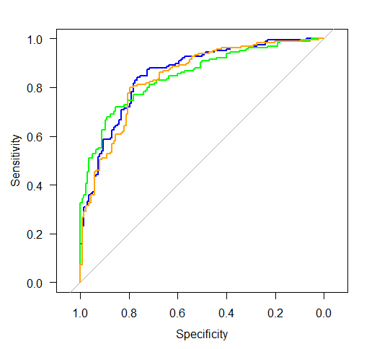
Comparing methods
ROC curve for the heart disease dataset using logistic regression – AUC = 0.856
ROC curve for the same dataset using randomForest – AUC = 0.848 or
Naïve Bayes – AUC = 0.842
Notes:
4

Slide 19
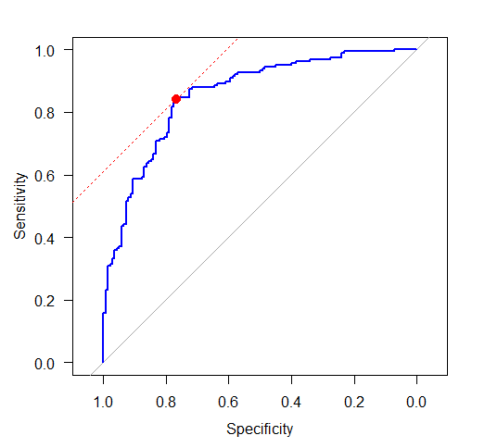
Choosing threshold
In most situations, the best threshold is the one giving highest specificity and sensitivity
But… sometimes you may want to compromise on one of the two!
Notes:
4

Slide 20
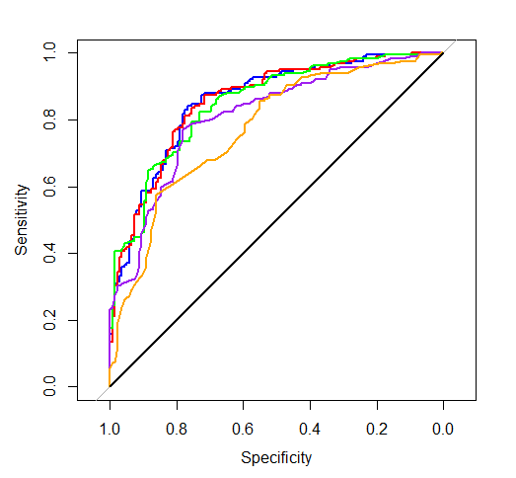
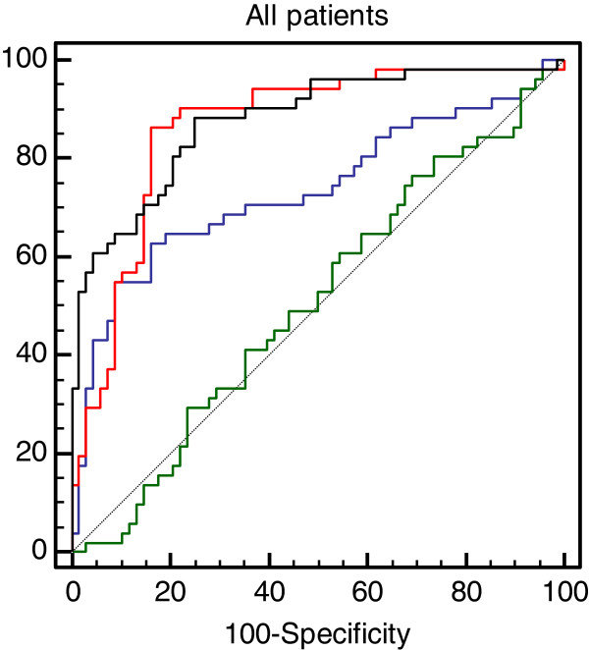
Choosing predictors
Logistic regression on the heart disease dataset
Blue curve is ROC for full model, black curve for intercept-only model
Other curves have different numbers of predictors
ROC curves for models using different predictors.
From Yates et al. 2013
Notes:
4

Slide 21
Summary
Classification models allow prediction of discrete outcomes
Cross-validation allows to avoid overfitting
Confusion matrices and ROC curves allow to compare models
Next week… some practical examples of classification models!
Notes:
4

